Slide 1


COM3123 - Lecture 1
Full Stack Web Development

Slide 2
Topics
Introduction
Full Stack vs MEAN Stack
Evolution of JavaScript
Main goals of JavaScript & ES6
ES6 Features

Slide 3

Professor
Senior UI/Full Stack Developer
13 Years experience building web applications
Specialization in Microsoft .NET and JavaScript Frameworks
2018/2019 Professor - COM3123/COM3133
https://www.linkedin.com/in/mike-denton-1988597/

Slide 4

Assistant Instructor
Senior Software Developer
5 Years experience building web applications
Specialization in Angular and Ionic Frameworks
2018/2019 Assistant Instructor - COM3123/COM3133
https://www.linkedin.com/in/alla-abramova-4a652297/

Slide 5
FULL STACK VS MEAN STACK

Slide 6
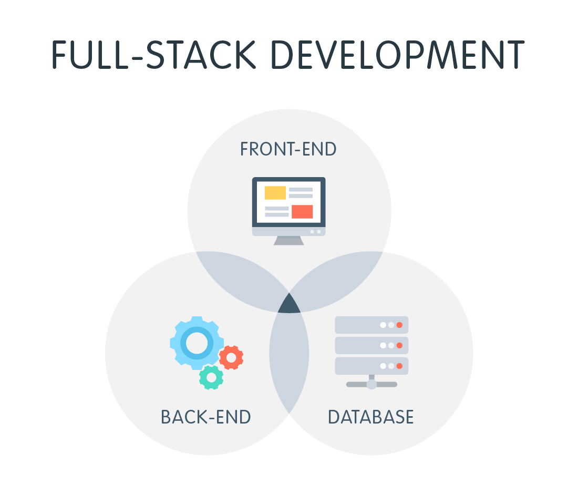

Slide 7
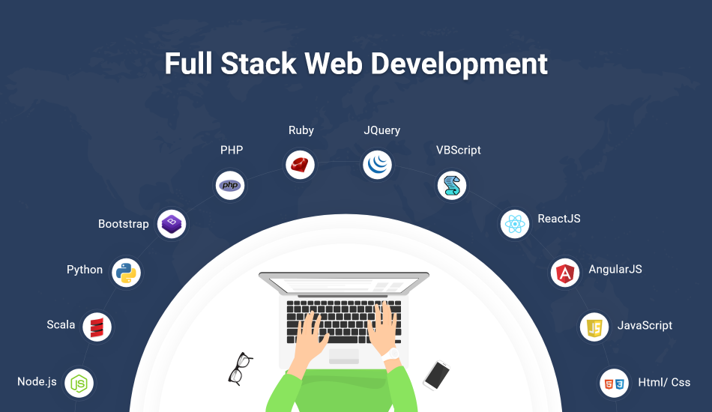

Slide 8
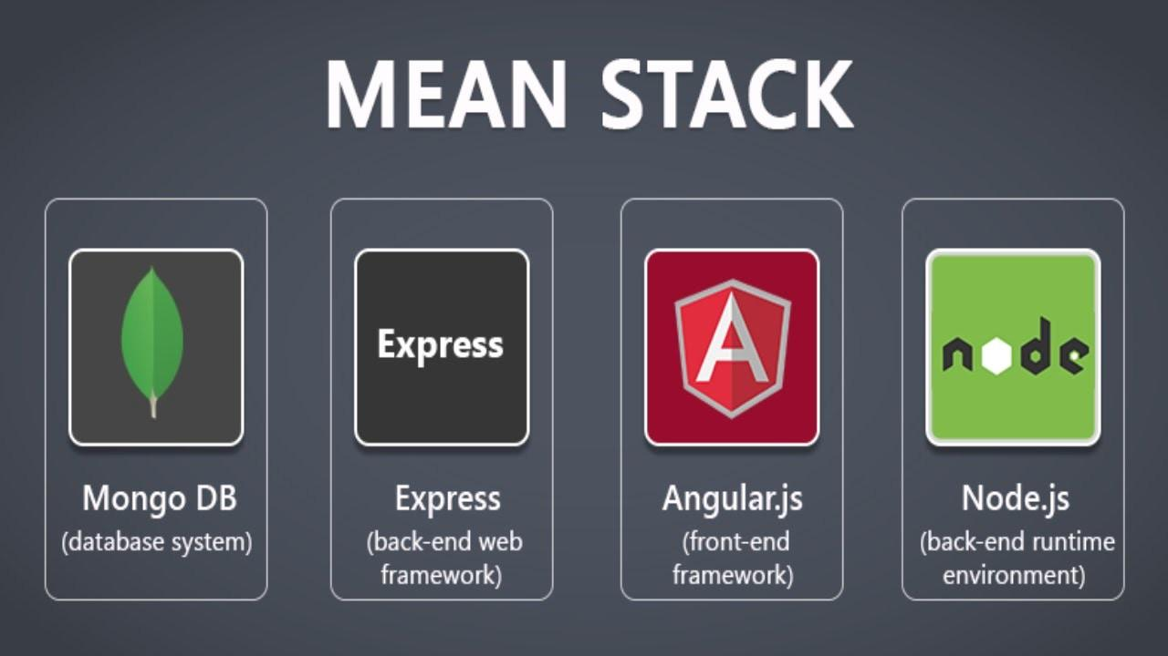

Slide 9

Definitions
JavaScript (JS) - a high level, dynamic, untyped and interpreted programming language created original for web browsers
ECMA International - an international non-profit standards organization (European Computer Manufacturers Association)
ECMAScript (ES) - scripting-language specification standardized by ECMA International. (Implemented well known languages such as JavaScript, JScript and ActionScript)
ES2015 (ES6) - the newest version of ECMAScript
https://www.ecma-international.org/

Slide 10
JavaScript Evolution

Slide 11

1990’s
1995: Netscape creates Mocha
1995: Mocha > LiveScript > JavaScript
1996: ECMA adopts JavaScript
1997: ECMA-262 (ES1)
1998: ES2
1999: ES3 (regex, try/catch)
* 1990's browser wars IE vs Netscape

Slide 12


2000-2004
Browser wars - IE wins and becomes the dominant web browser
Not a lot of innovation happening the JS world at this time.
GMail was launched in 2004. It was the first popular web application that really showed off what was possible with client-side JavaScript

Slide 13
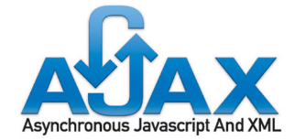




2005: AJAX
Broadband Internet becomes popular
Asynchronous server requests (AJAX) become popular
Renaissance of JavaScript
Countless JavaScript libraries emerge (mainly helping with AJAX requests and DOM operations)

Slide 14

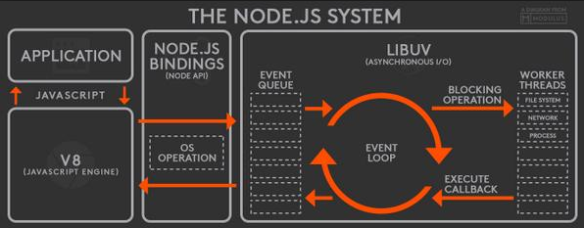
2006-2009
2008: ECMAScript4 (abandoned)
2009: ECMAScript 3.1 5 (strict, JSON, Reflect)
2009: Emergence of Server Side JavaScript environment => Node.js

Slide 15

2010-2015
frameworks continue to evolve, no longer just DOM & AJAX helpers
JS Packet Manager ie. npm, bower
solutions for keeping code in modules (node.js, CommonJs, AMD, Browserify)
JavaScript preprocessors (Grunt, Gulp, Webpack..)

Slide 16
JavaScript Programming Language

Slide 17
Why should you learn vanilla JavaScript before frameworks?
If you master JavaScript fundamentals, your only challenge when learning new JS frameworks will be scoped to their specific syntax.
Understanding JavaScript’s core engineering principles is paramount, if you want to build yourself a decent web career.
In the past 5 years, more than 10 frontend JS frameworks made the news. Guess how many will do the same in the next 5-10 years?
"JQuery developers" are trying to catch up on Angular. Tomorrow, they'll be trying to catch up on React/Vue, and the loop will continue as technology advances..

Slide 18
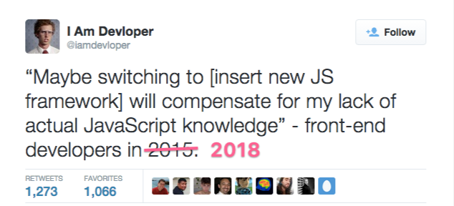
Vanilla JS..
VanillaJS is a name to refer to using plain JavaScript without any additional libraries like jQuery.

Slide 19
JavaScript Pros/Cons
Pros
easy syntax
functions are objects
the only native web browser language
independently driven
Cons
not many clean code practices
each framework = new practices, enforcing bad practices overall
very rapid development often makes tools and frameworks obsolete fast
Notes:
http://andyshora.com/slagging-off-javascript-frameworks.html

Slide 20
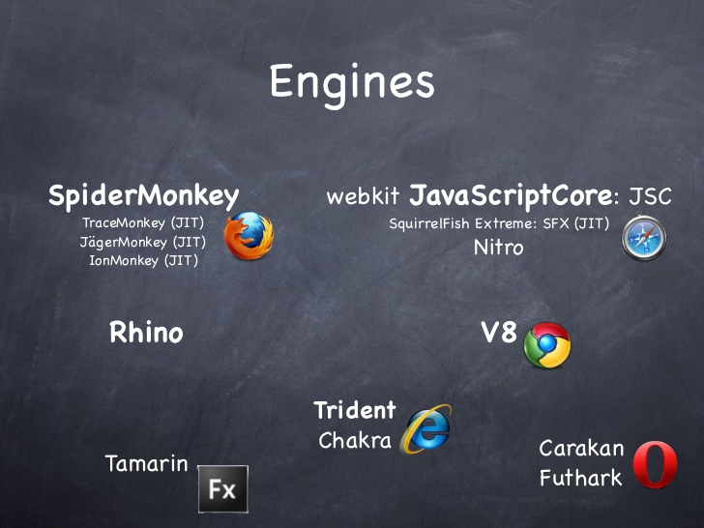
Where does JavaScript code run?
JavaScript was originally designed to run only in browsers, so every browser has a JavaScript engine that can execute JavaScript code.

Slide 21
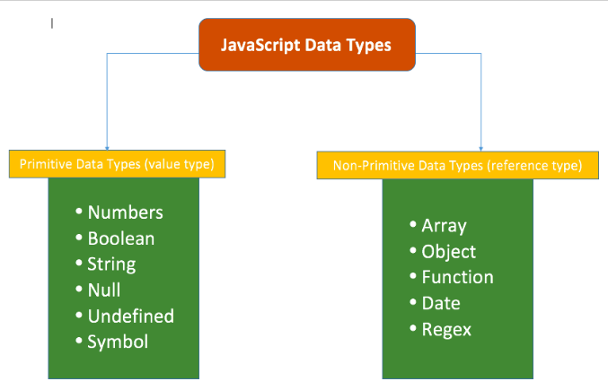
Primitive Data Types vs Reference Types

Slide 22
Dynamic vs Static Typing
Static Typing: (Java)
String name; Variables have types
name = ‘Mike’; Values have types
name = 34; Variables cannot change type
Dynamic Typing: (JavaScript)
var name; Variables have no types
name = "John"; Values have types
name = 34; Variables change type dynamically

Slide 23
ES6

Slide 24
ES6 Main Goals
Fix (some of) ES5 problems
backwards compatibility (Babel is a compiler to translate ES6 code to make valid ES5)
modern syntax
better suited for bigger complex application (ie. native modules)
new features in the standard library (ie. native class support, arrow functions, modules)

Slide 25
ES6 new syntax

Slide 26
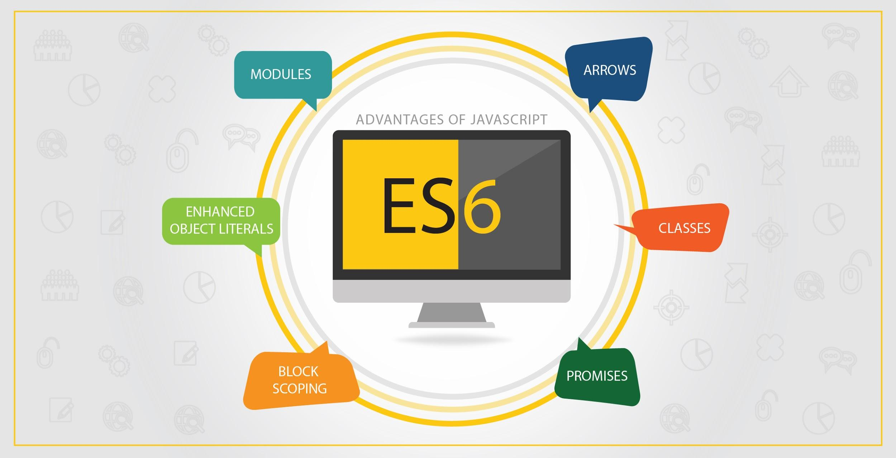

Slide 27
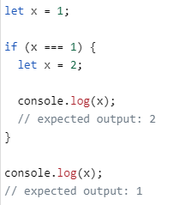
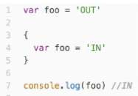
let statement
The let statement declares a block scope local variable, optionally initializing it to a value.
ES5 var statement

Slide 28
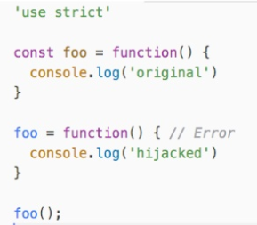
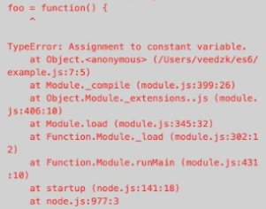
const statement
Constants are block-scoped, much like variables defined using the let statement. The value of a constant cannot change through reassignment, and it can't be redeclared.

Slide 29
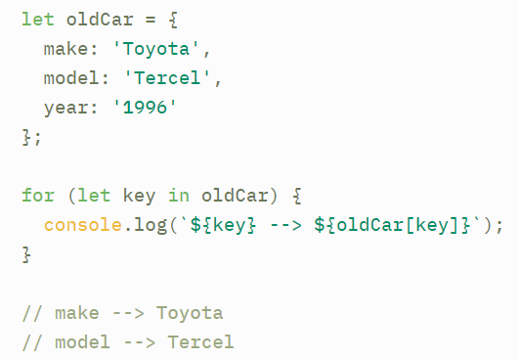
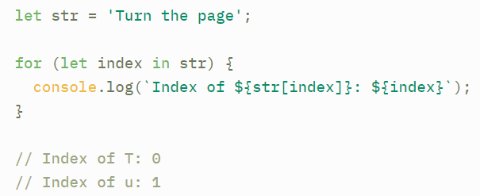
for in... statement
Use for…in to iterate over the properties of an object (the object keys)
Also use for…in to iterate over the index values of an iterable like an array or a string
Iterating over object
Iterating over string

Slide 30
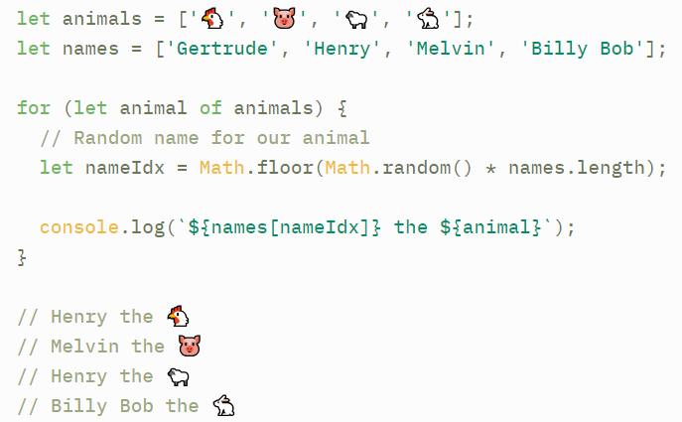
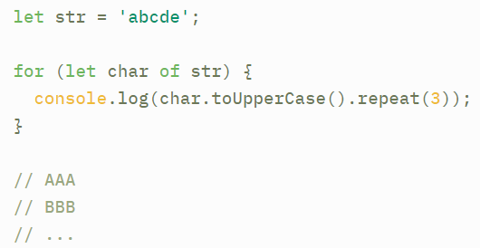
for of... statement
Use for...of to iterate over the values in an iterable ie. array, string
Also can iterate over maps, sets, generators, DOM node collections and the arguments object available inside a functions.

Slide 31
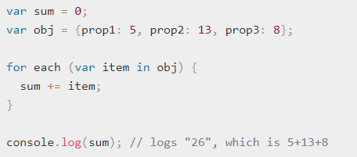
for each in..statement
The for each...in statement is deprecated, best practice do not use it.
Firefox now warns about the usage of for each...in and it no longer works starting with Firefox 57.

Slide 32
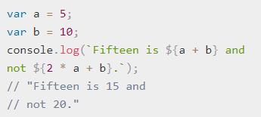
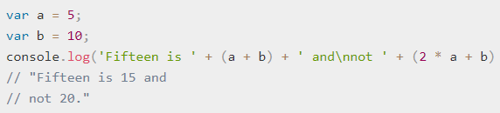
template literals
Template literals are string literals allowing embedded expressions. You can use multi-line strings and string interpolation features with them. (ES5 => template strings)
ES6: Template Literals
ES5: Embedded Expressions with normal strings

Slide 33
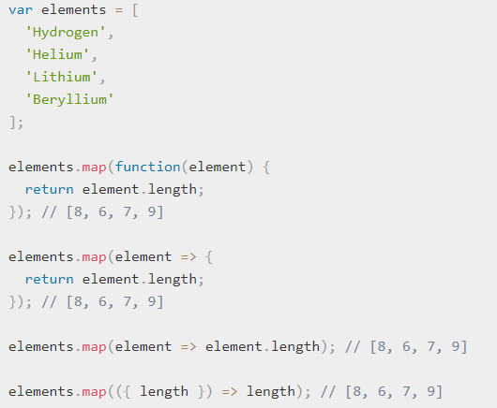
Arrow functions
An arrow function expression has a shorter syntax than a function expression and does not have its own this, arguments, super, or new.target.
These function expressions are best suited for non-method functions, and they cannot be used as constructors.

Slide 34

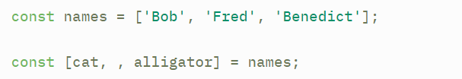
Destructuring.
Destructuring syntax allows you to extract data from arrays and objects with more ease and less syntactic clutter.
We can extract properties from the object and assign them to new const variables
Object Destructuring
Array Destructuring (use comma to skip items)

Slide 35
Object & Arrays

Slide 36
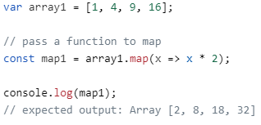
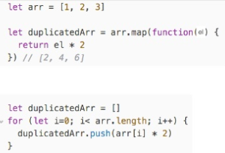
ES5 recap: map
The array.proto.map() method creates a new array with the results of calling a provided function on every element in the calling array.
Array.map()
Array.map() vs for loop

Slide 37
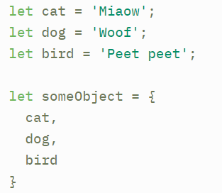
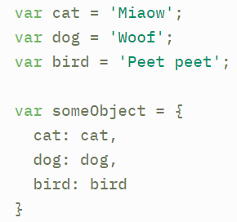
Object property declaration
Shorthand key names can now be used to define an object, when key's have same name as variables passed in as properties.
ES6 Syntax
ES5 Syntax

Slide 38
Classes

Slide 39
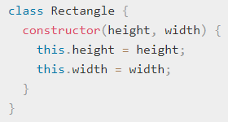
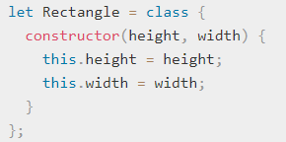
Classes
JavaScript classes, introduced in ECMAScript 2015, are primarily syntactical sugar over JavaScript's existing prototype-based inheritance.
The class syntax does not introduce a new object-oriented inheritance model to JavaScript.
* Function declaration are hoisted, class declaration are not.
Class declaration
Class Expression

Slide 40
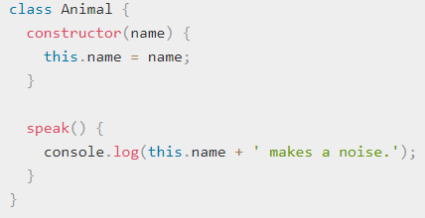
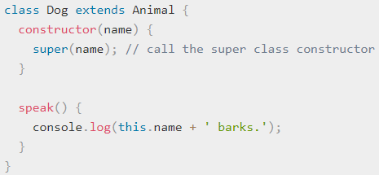

Sub classing with extends
The extends keyword is used in class declarations or class expressions to create a class as a child (sub class) of another class.

Slide 41
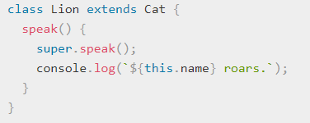
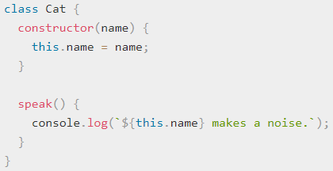

Super class calls with super
The super keyword is used to call corresponding methods of super class. This is one advantage over prototype-based inheritance.
sub class
super class
output

